Slide 1
TERMINOLOGY WITHOUT BORDERS
Ida Mareckova
Terminology Coordination
DG TRAD European Parliament

Slide 2
TERMINOLOGY WITHOUT BORDERS
new type of collaboration of the Terminology Coordination Unit of the Directorate-General for Translation (DG TRAD) with EU agencies, international organisations and civil society
creation of a new website: yourterm.org
the main aim of the project
to enhance communication in a number of domains by tailoring terminology to citizens’ needs producing multilingual terminology projects
to reflect and support the goal of DG TRAD to communicate
with citizens in clear language

Slide 4
WORKFLOW
Project Launch
TermCoord and Steering Committee
Term Extraction from Corpora in source language
University or TermCoord
Research for equivalents in various target languages
University
Revision and validation of terms
Experts of the partner organisations

Slide 5
PROJECT SECTIONS
Each project contains:
a resource centre (terminology resources made available to the website users and serving as reference for the terminology work)
a description of the project with the participants (university departments: professor and students, individual participants)
the terminology tables in all languages containing terms, definitions and reference

Slide 6
EXAMPLE OF A RESOURCE CENTER: YOURTERM MED
Resources:
COVID-19 Resources
Vaccines Resources
Eponyms Resources

Slide 7
EXAMPLE OF A COLLABORATION SECTION: YOURTERM CULT https://yourterm.org/cult-terminology-projects/

Slide 8
EXAMPLE OF TERMINOLOGY SECTION: YOURTERM MARE
Project on fishing and maritime domains
Cooperation with EU agencies EFCA, EMSA, CdT
Cooperation with UN agencies IMO and FAO
Terminology:
maritime safety
ship constructions
commercial and scientific names of fish species

Slide 9
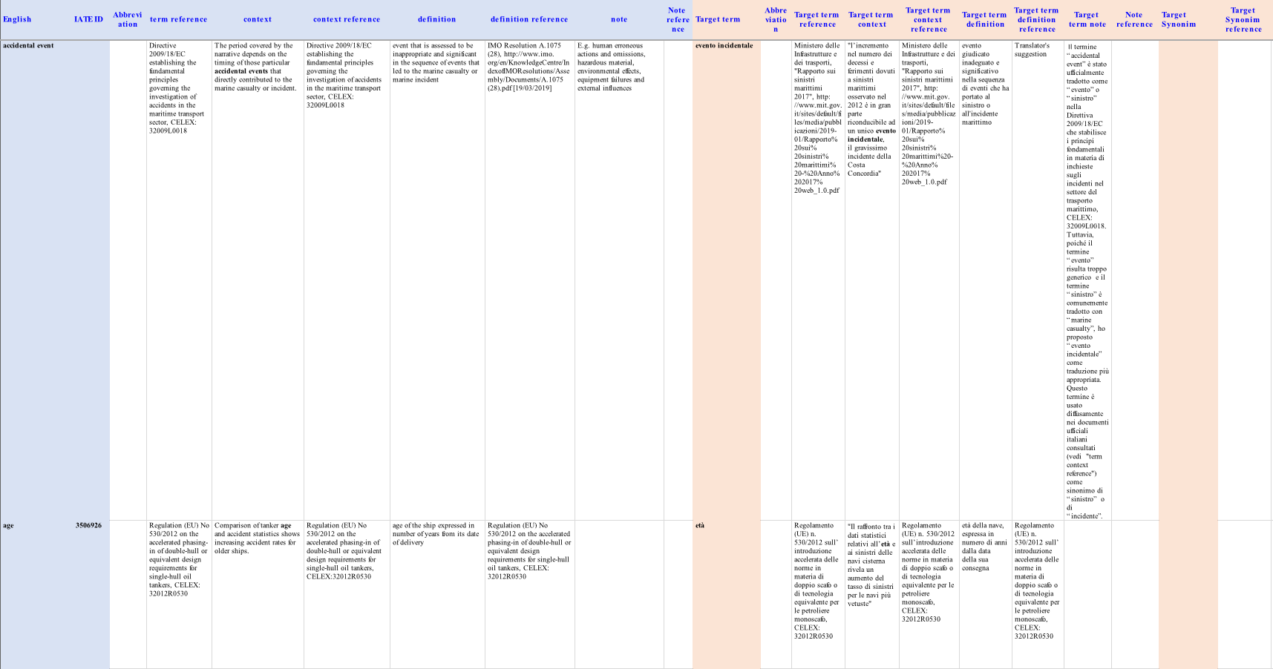
FIRST RESULTS Published Terminology Table

Slide 10
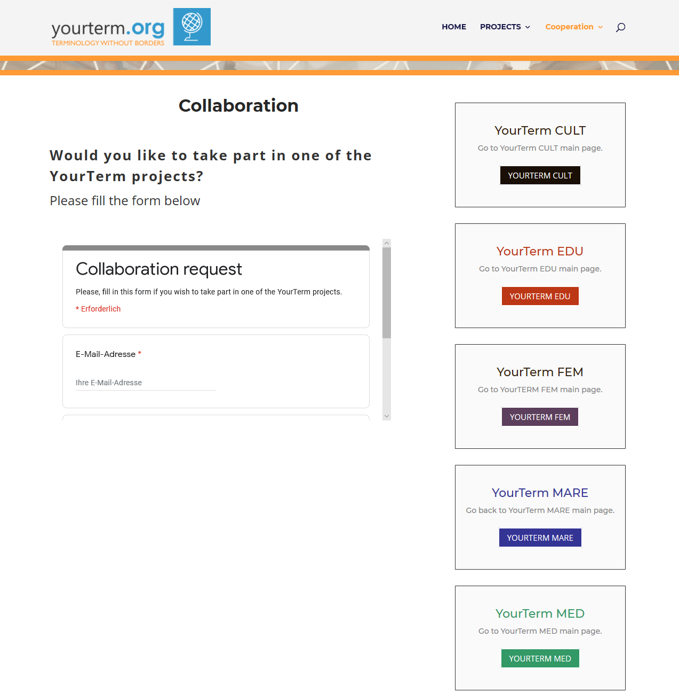
APPLY ONLINE
Click here

Slide 11
THANK YOU FOR YOUR ATTENTION!

